Slide 1
Agents and environments
Agent
Environment
Sensors
Percepts
?
Actuators
Actions
An agent perceives its environment through sensors and acts upon it through actuators (or effectors, depending on whom you ask)

Slide 2
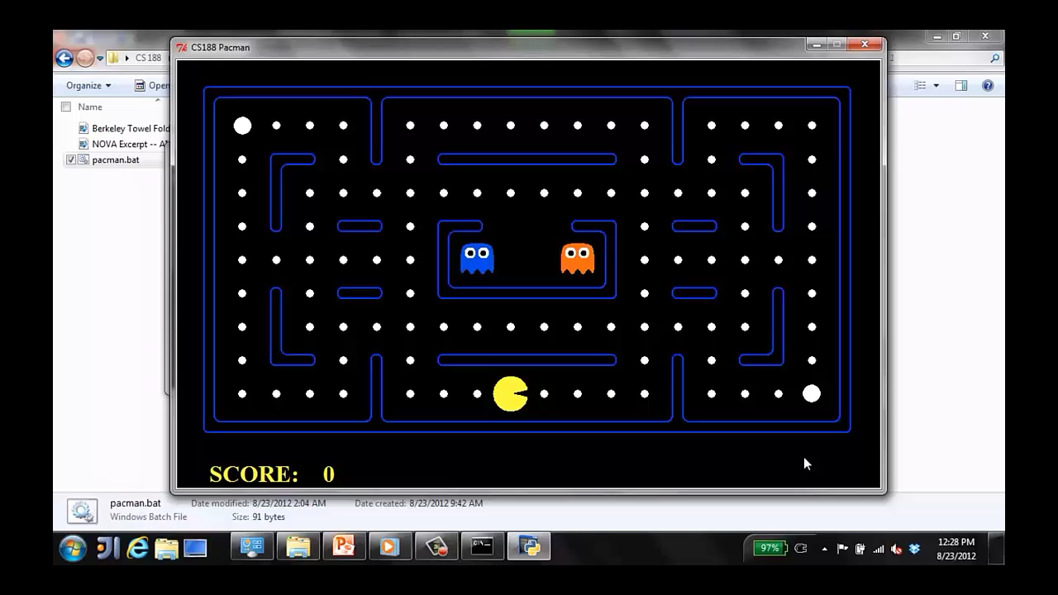
A human agent in Pacman

Slide 3
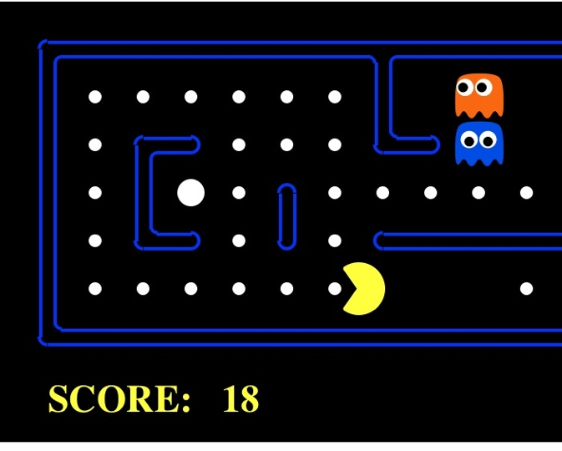
The task environment - PEAS
Performance measure
-1 per step; + 10 food; +500 win; -500 die; +200 hit scared ghost
Environment
Pacman dynamics (incl ghost behavior)
Actuators
Left Right Up Down or NSEW
Sensors
Entire state is visible (except power pellet duration)

Slide 4
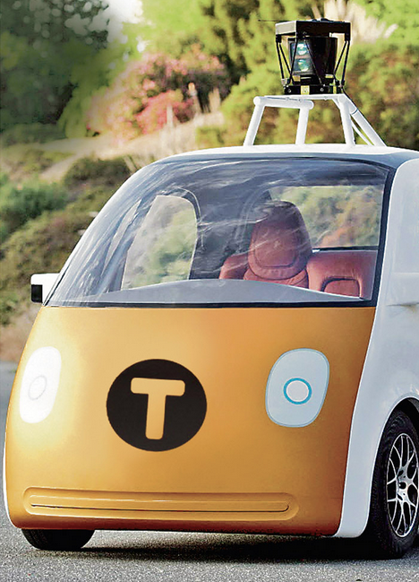
PEAS: Automated taxi
Performance measure
Income, happy customer, vehicle costs, fines, insurance premiums
Environment
US streets, other drivers, customers, weather, police…
Actuators
Steering, brake, gas, display/speaker
Sensors
Camera, radar, accelerometer, engine sensors, microphone, GPS
Image: http://nypost.com/2014/06/21/how-google-might-put-taxi-drivers-out-of-business/

Slide 5


PEAS: Medical diagnosis system
Performance measure
Patient health, cost, reputation
Environment
Patients, medical staff, insurers, courts
Actuators
Screen display, email
Sensors
Keyboard/mouse

Slide 6
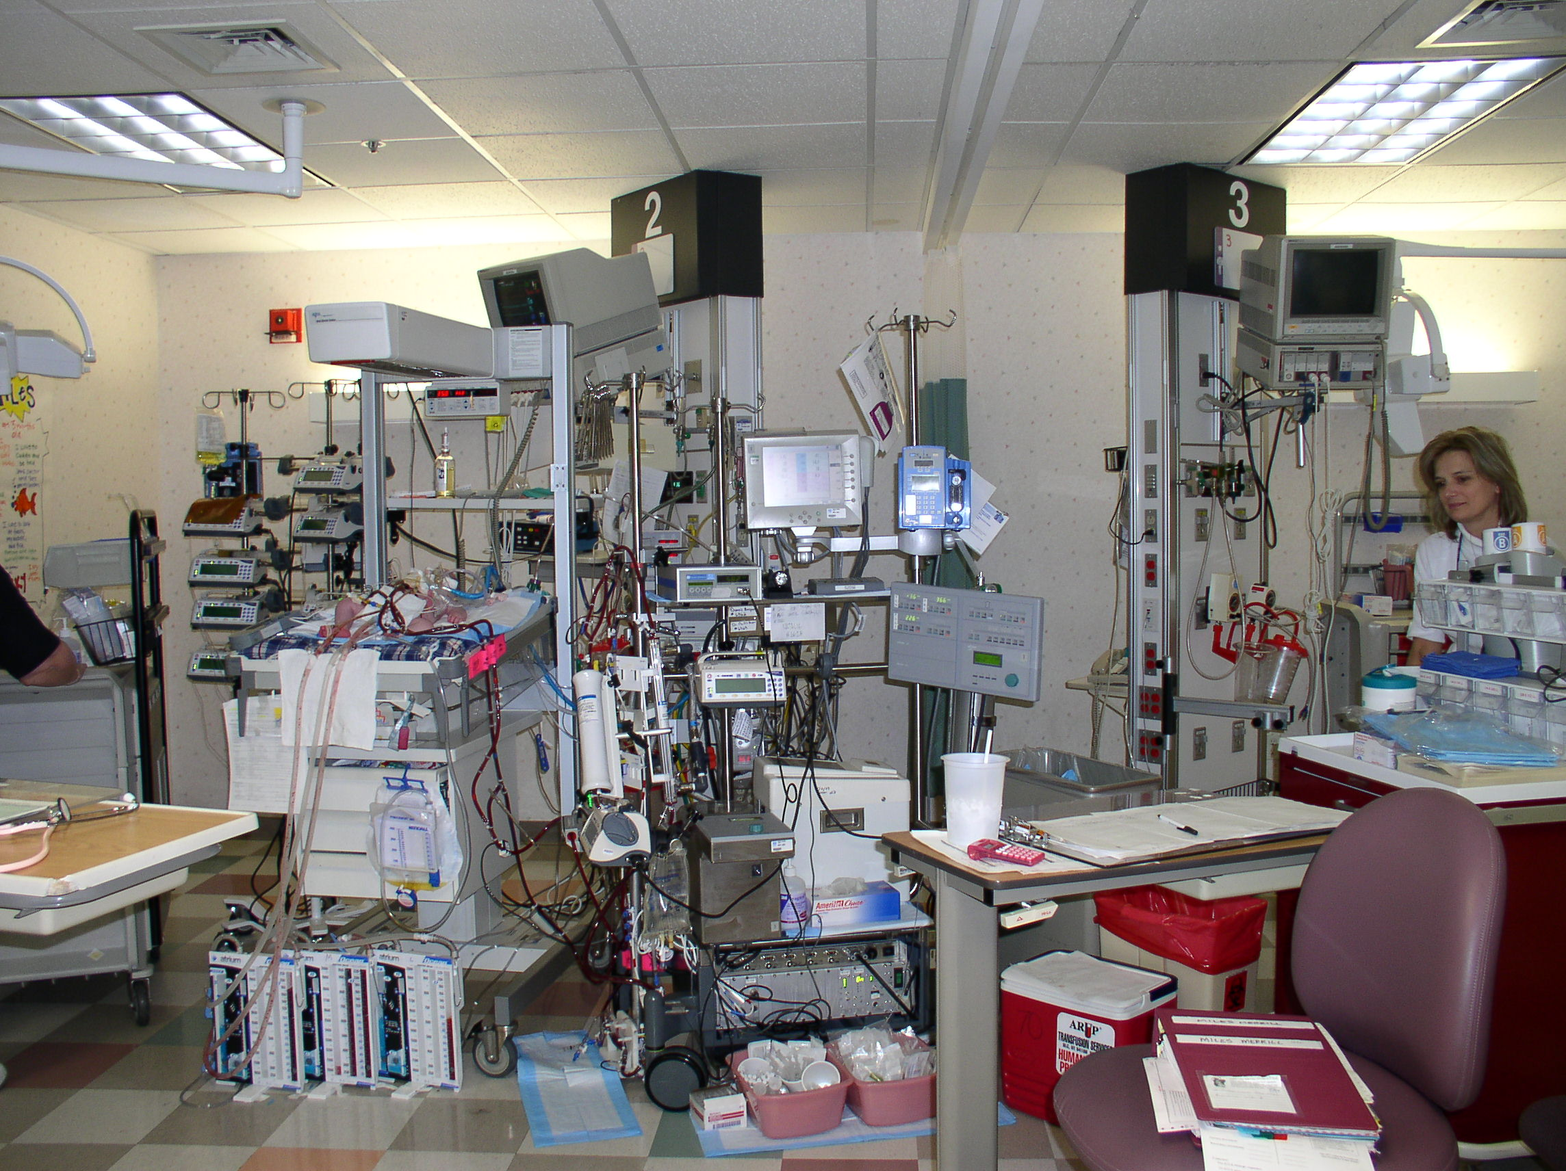

Slide 7
Environment types
 | Pacman | Backgammon | Diagnosis | Taxi
Fully or partially observable
Single-agent or multiagent
Deterministic or stochastic
Static or dynamic
Discrete or continuous
Known physics?
Known perf. measure?

Slide 8
Agent design
The environment type largely determines the agent design
Partially observable => agent requires memory (internal state)
Stochastic => agent may have to prepare for contingencies
Multi-agent => agent may need to behave randomly
Static => agent has time to compute a rational decision
Continuous time => continuously operating controller
Unknown physics => need for exploration
Unknown perf. measure => observe/interact with human principal

Slide 9
Simple reflex agents

Slide 10
Pacman agent in Python
class GoWestAgent(Agent):
def getAction(self, percept):
if Directions.WEST in percept.getLegalPacmanActions():
return Directions.WEST
else:
return Directions.STOP

Slide 11
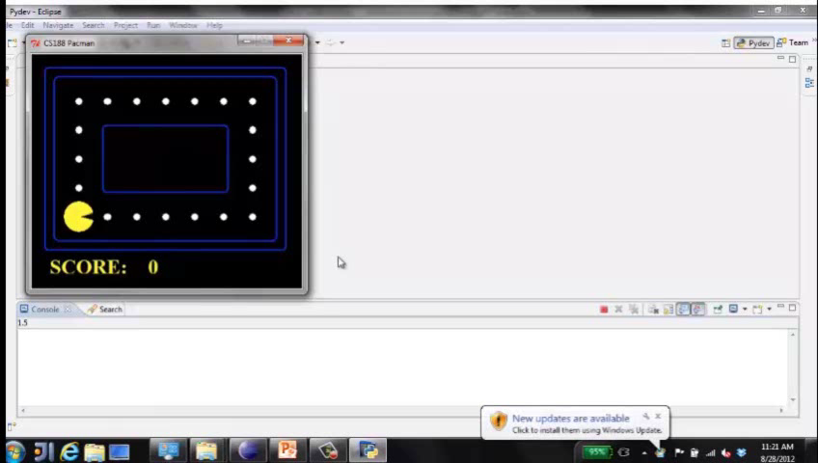
Eat adjacent dot, if any
Notes:
Optimal in some environments!

Slide 12
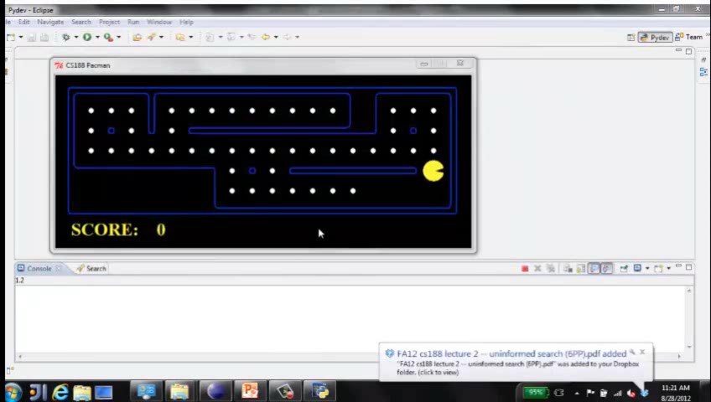
Eat adjacent dot, if any
Notes:
Not so great in others

Slide 13
Pacman agent contd.
Can we (in principle) extend this reflex agent to behave well in all standard Pacman environments?
No – Pacman is not quite fully observable (power pellet duration)
Otherwise, yes – we can (in principle) make a lookup table…..
How large would it be?
Notes:
106 locations so 106^3 * 2^106 (ignoring power pellet stuff) =~ 10^38 states
Worse if the map is not fixed – all possible physics? No – can simply say 3^150 or whatever

Slide 14
Reflex agents with state

Slide 15
Goal-based agents
Notes:
Act to achieve a goal
Pro: use goal to index into actions that might achieve it, eg “Have milk” -> “buy milk”
Con: cannot handle tradeoffs among goals, failure probability etc.

Slide 16
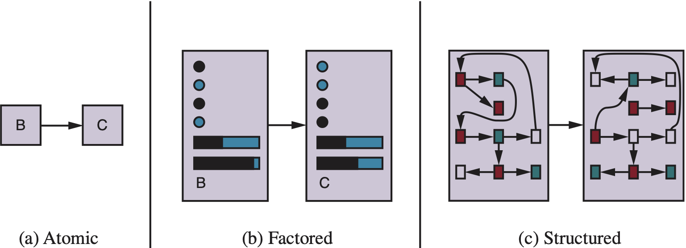
Spectrum of representations

Slide 17
Outline of the course
unknown
RL
known
deterministic
stochastic
atomic
SEARCH
MDPs
factored
LOGIC
Bayes nets
structured
First-order logic

Slide 18
Summary
An agent interacts with an environment through sensors and actuators
The agent function, implemented by an agent program running on a machine, describes what the agent does in all circumstances
Rational agents choose actions that maximize their expected utility
PEAS descriptions define task environments; precise PEAS specifications are essential and strongly influence agent designs
More difficult environments require more complex agent designs and more sophisticated representations

Slide 19

CS 188: Artificial Intelligence
Search
Instructors: Stuart Russell and Dawn Song
University of California, Berkeley
[slides adapted from Dan Klein, Pieter Abbeel]
Notes:
Please retain proper attribution, including the reference to ai.berkeley.edu. Thanks!

Slide 20
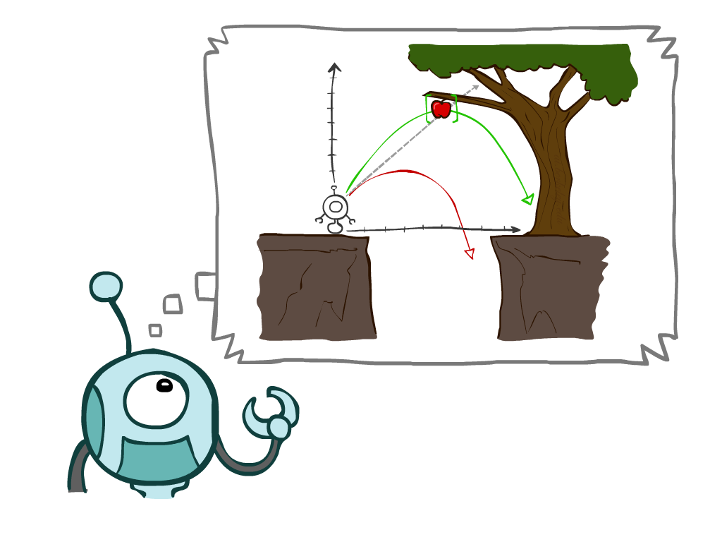
Today
Agents that Plan Ahead
Search Problems
Uninformed Search Methods
Depth-First Search
Breadth-First Search
Uniform-Cost Search
Notes:
General theme in the class:
A goal we have in mind.
A mathematical abstraction to formalize this
Algorithms that operate on these abstractions

Slide 21
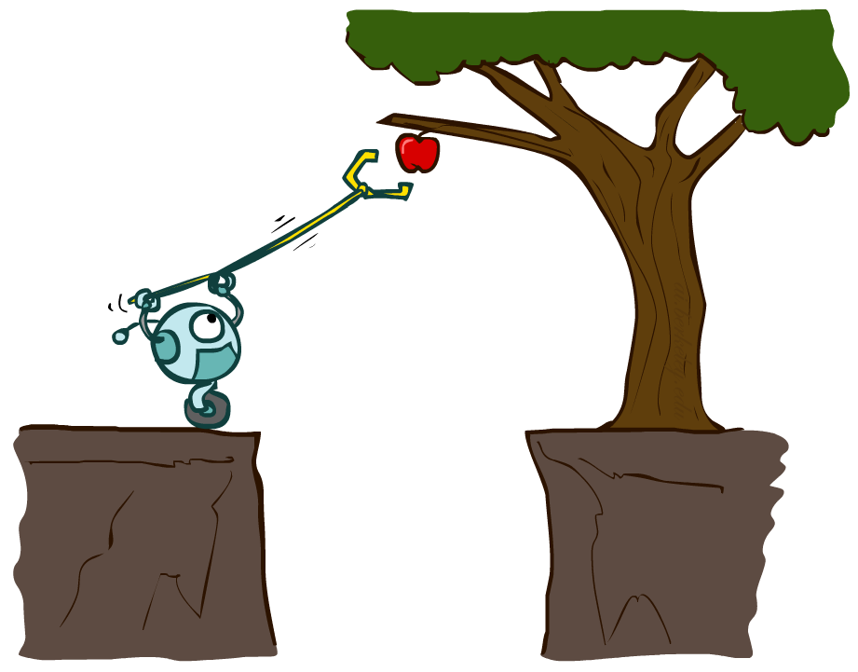
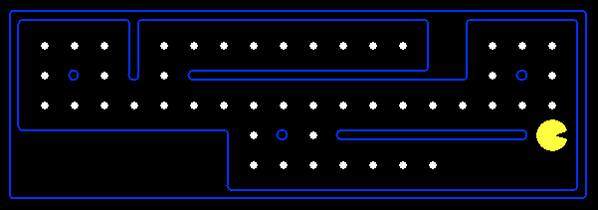
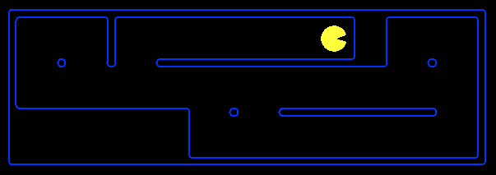
Planning Agents
Planning agents decide based on evaluating future action sequences
Must have a model of how the world evolves in response to actions
Usually have a definite goal
Optimal: Achieve goal at least cost

Slide 22
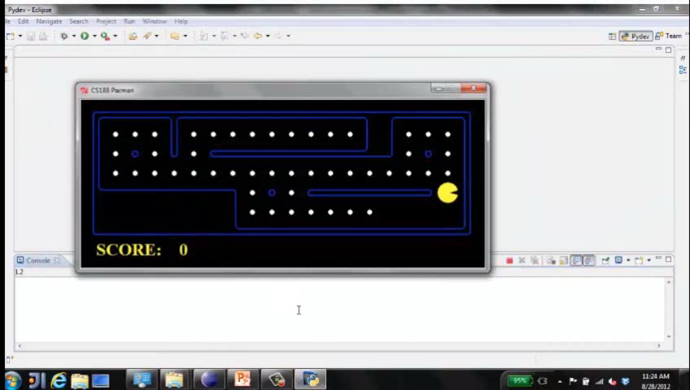
Move to nearest dot and eat it

Slide 23
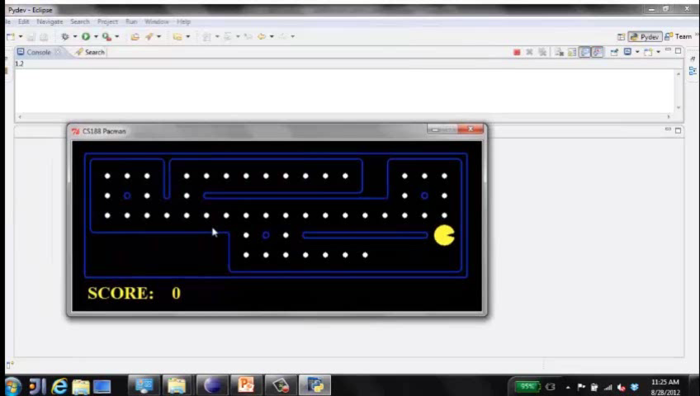
Precompute optimal plan, execute it

Slide 24
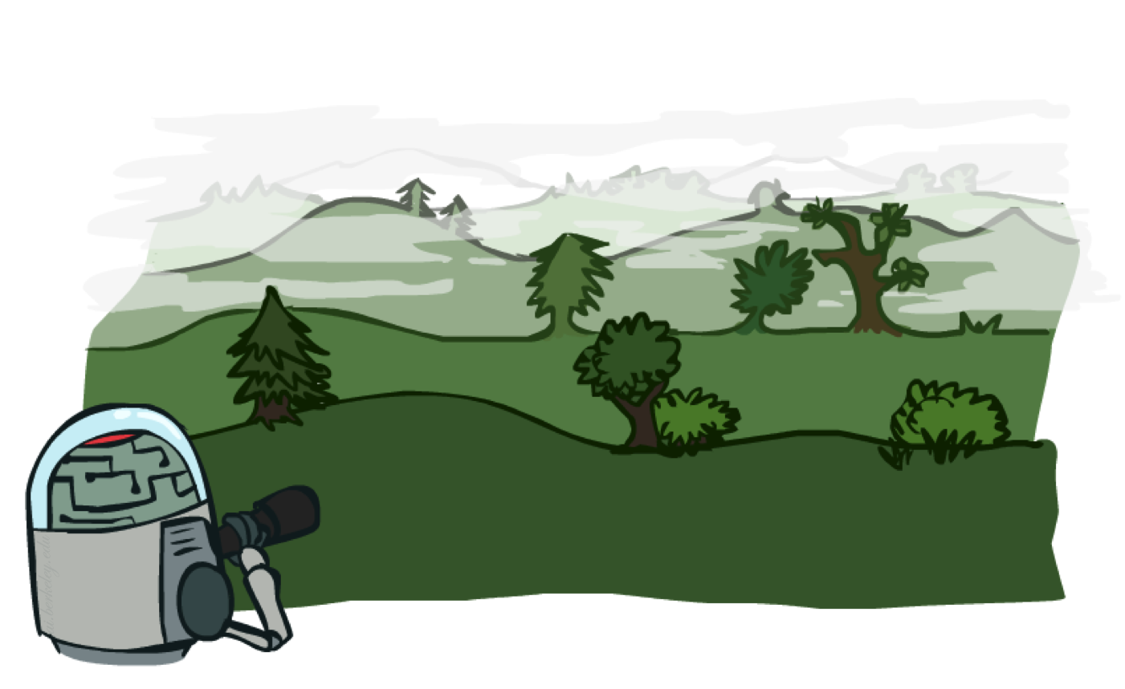
Search Problems

Slide 25

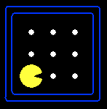





Search Problems
A search problem consists of:
A state space S
An initial state s₀
Actions A(s) in each state
Transition model Result(s,a)
A goal test G(s)
S has no dots left
Action cost c(s,a,s’)
+1 per step; -10 food; -500 win; +500 die; -200 eat ghost
A solution is an action sequence that reaches a goal state
An optimal solution has least cost among all solutions
N
-9
-9
E
Notes:
Often comes back on exams
Goal test – sometimes more than one state that satisfies having achieved the goal, for example, “eat all the dots”
Abstraction

Slide 26

Search Problems Are Models

Slide 27

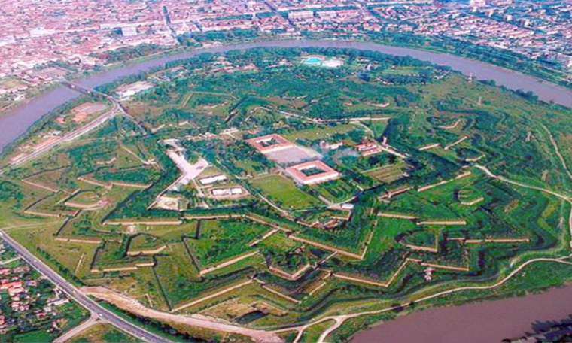
Example: Traveling in Romania

Slide 28
But then…

Slide 29
Example: Traveling in Romania
State space:
Cities
Initial state:
Arad
Actions:
Go to adjacent city
Transition model:
Reach adjacent city
Goal test:
s = Bucharest?
Action cost:
Road distance from s to s’
Solution?

Slide 30
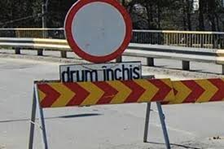
Models are almost always wrong

Slide 31
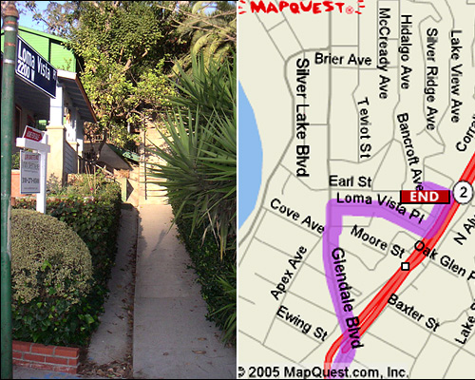
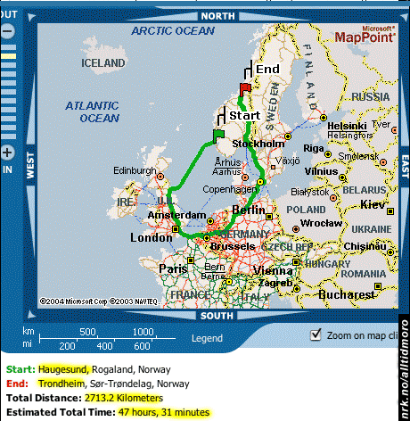
Models are almost always wrong

Slide 32
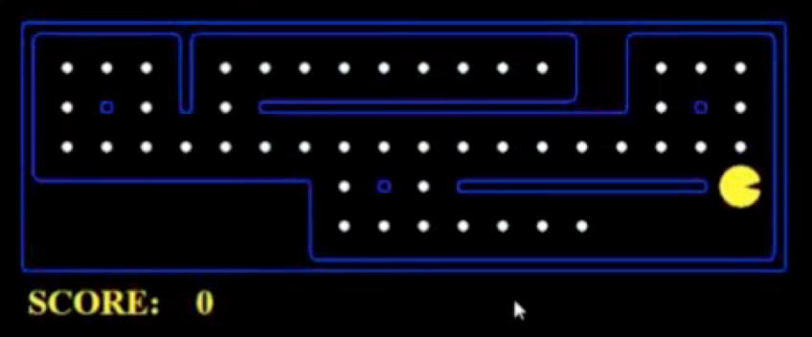
What’s in a State Space?
The world state includes every last detail of the environment
A search state keeps only the details needed for planning (abstraction)
Problem: Pathing
States: (x,y) location
Actions: NSEW
Transition: update x,y value
Goal test: is (x,y)=destination
Problem: Eat-All-Dots
States: {(x,y), dot Booleans}
Actions: NSEW
Transition: update x,y and possibly a dot Boolean
Goal test: dots all false
Notes:
Wrong example for “eat-all-dots”: (x, y, dot count)

Slide 33
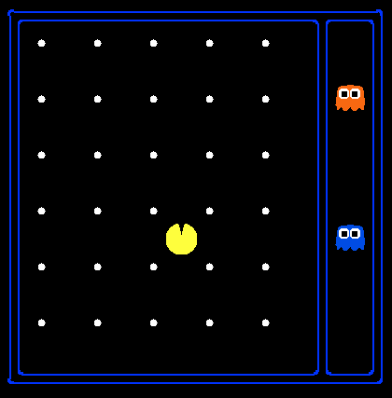
State Space Sizes
World state:
Agent positions: 120
Food count: 30
Ghost positions: 12
Agent facing: NSEW
How many
World states?
120x(2³⁰)x(12²)x4
States for pathing?
120
States for eat-all-dots?
120x(2³⁰)
Notes:
90 * (2^30-1) + 30 * 2^29 = 145 billion
2^29 = 536 870 912

Slide 34
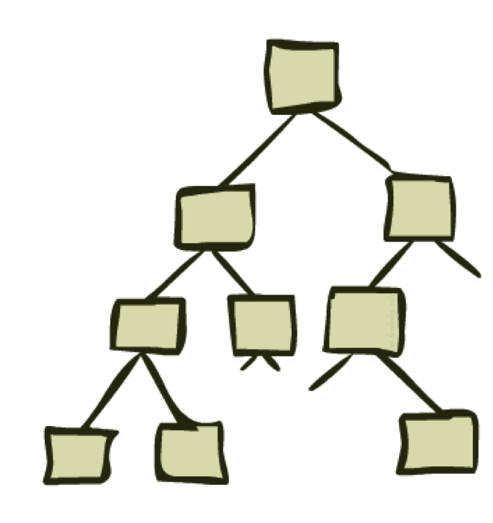
State Space Graphs and Search Trees

Slide 35
State Space Graphs
State space graph: A mathematical representation of a search problem
Nodes are (abstracted) world configurations
Arcs represent transitions (labeled with actions)
The goal test is a set of goal nodes (maybe only one)
In a state space graph, each state occurs only once!
We can rarely build this full graph in memory (it’s too big), but it’s a useful idea

Slide 36
State Space Graphs
State space graph: A mathematical representation of a search problem
Nodes are (abstracted) world configurations
Arcs represent successors (action results)
The goal test is a set of goal nodes (maybe only one)
In a state space graph, each state occurs only once!
We can rarely build this full graph in memory (it’s too big), but it’s a useful idea
a
G
b
c
e
d
f
S
h
p
q
r
Tiny state space graph for a tiny search problem

Slide 37
State Space Graphs vs. Search Trees
State Space Graph
Each NODE in in the search tree is an entire PATH in the state space graph.
Search Tree
S
a
G
d
e
p
b
c
q
b
c
e
h
r
d
e
f
a
a
h
r
p
q
f
S
h
We construct the tree on demand – and we construct as little as possible.
p
q
f
q
c
G
p
q
r
q
c
G
a
a

Slide 38

Quiz: State Space Graphs vs. Search Trees
Consider this 4-state graph:
How big is its search tree (from S)?
a
S
G
b

Slide 39
Quiz: State Space Graphs vs. Search Trees
Consider this 4-state graph:
How big is its search tree (from S)?
a
s
a
b
S
G
b
G
a
G
b
a
G
b
G
…
…
Important: Those who don’t know history are doomed to repeat it!

Slide 40
Quiz: State Space Graphs vs. Search Trees
Consider a rectangular grid:
How many states within d steps of start?
How many states in search tree of depth d?

Slide 41
Tree Search

Slide 42
Search Example: Romania

Slide 43
Creating the search tree

Slide 44
Creating the search tree

Slide 45
Creating the search tree

Slide 46
General Tree Search
Main variations:
Which leaf node to expand next
Whether to check for repeated states
Data structures for frontier, expanded nodes

Slide 47
Systematic search
frontier
expanded
reached =
expanded U frontier
unexplored
Frontier separates expanded from unexplored region of state-space graph
Expanding a frontier node:
Moves a node from frontier into expanded
Adds nodes from unexplored into frontier, maintaining property 1

Slide 48

Depth-First Search

Slide 49
Depth-First Search
Strategy: expand a deepest node first
Implementation: Frontier is a LIFO stack
a
G
a
c
b
c
b
e
d
e
d
f
f
S
h
h
p
p
r
q
r
q
S
d
e
p
b
c
e
h
r
q
a
a
h
r
p
q
f
p
q
f
q
c
G
q
c
G
a
a

Slide 50
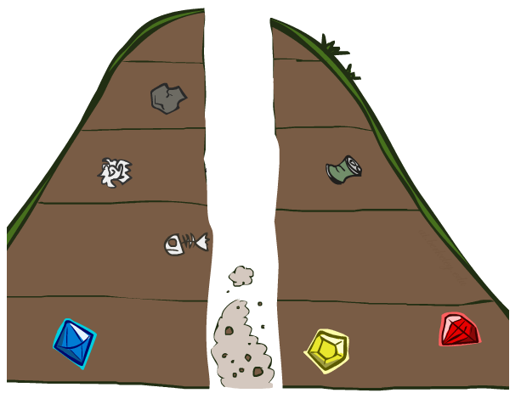
Search Algorithm Properties

Slide 51
Search Algorithm Properties
Complete: Guaranteed to find a solution if one exists?
Optimal: Guaranteed to find the least cost path?
Time complexity?
Space complexity?
Cartoon of search tree:
b is the branching factor
m is the maximum depth
solutions at various depths
Number of nodes in entire tree?
1 + b + b² + …. b^{m} = O(b^{m})
1 node
b
…
b nodes
b² nodes
m tiers
b^{m} nodes

Slide 52
Depth-First Search (DFS) Properties
What nodes does DFS expand?
Some left prefix of the tree down to depth m.
Could process the whole tree!
If m is finite, takes time O(b^{m})
How much space does the frontier take?
Only has siblings on path to root, so O(bm)
Is it complete?
m could be infinite
preventing cycles may help (more later)
Is it optimal?
No, it finds the “leftmost” solution, regardless of depth or cost
1 node
b
…
b nodes
b² nodes
m tiers
b^{m} nodes

Slide 53
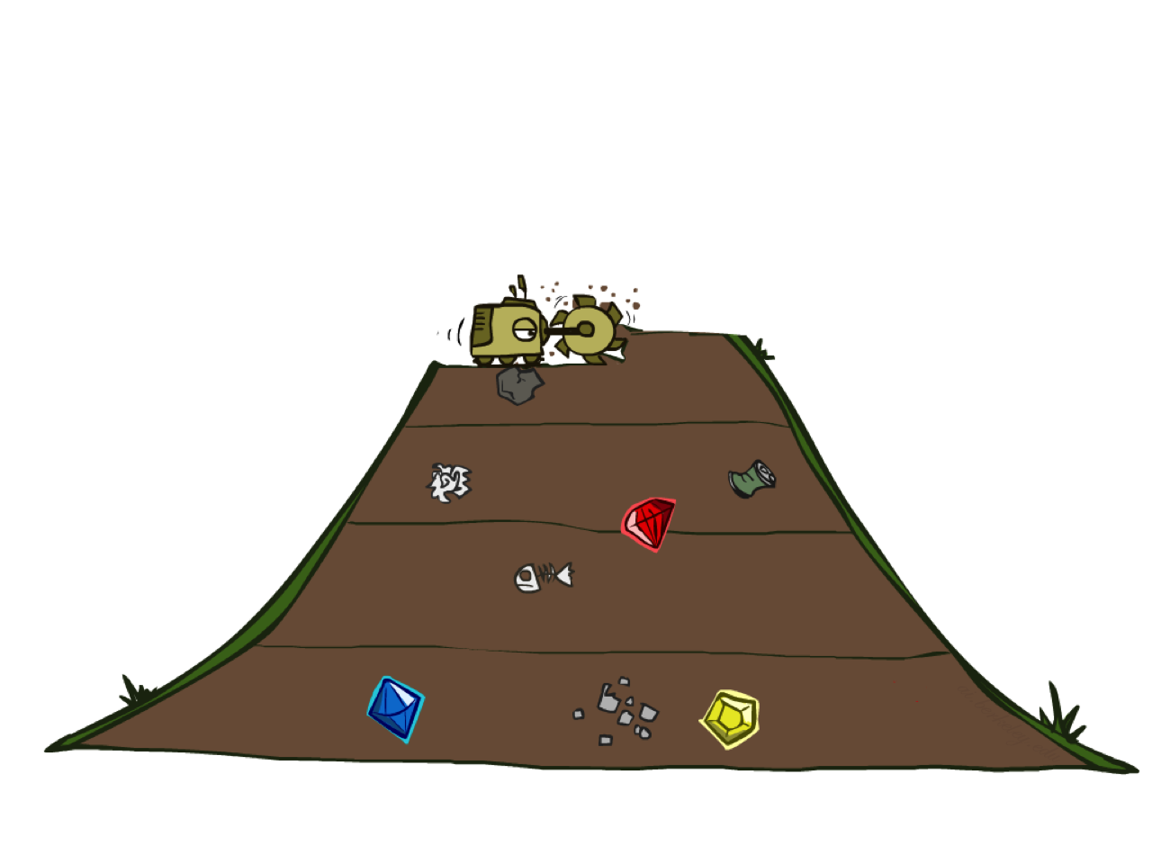
Breadth-First Search

Slide 54
Breadth-First Search
Strategy: expand a shallowest node first
Implementation: Frontier is a FIFO queue
a
G
b
c
d
e
f
S
h
p
q
r
S
d
e
p
Search
Tiers
b
c
e
h
r
q
a
a
h
r
p
q
f
p
q
f
q
c
G
q
c
G
a
a

Slide 55
Breadth-First Search (BFS) Properties
What nodes does BFS expand?
Processes all nodes above shallowest solution
Let depth of shallowest solution be s
Search takes time O(b^{s})
How much space does the frontier take?
Has roughly the last tier, so O(b^{s})
Is it complete?
s must be finite if a solution exists, so yes!
Is it optimal?
If costs are equal (e.g., 1)
1 node
b
…
b nodes
s tiers
b² nodes
b^{s} nodes
b^{m} nodes

Slide 56
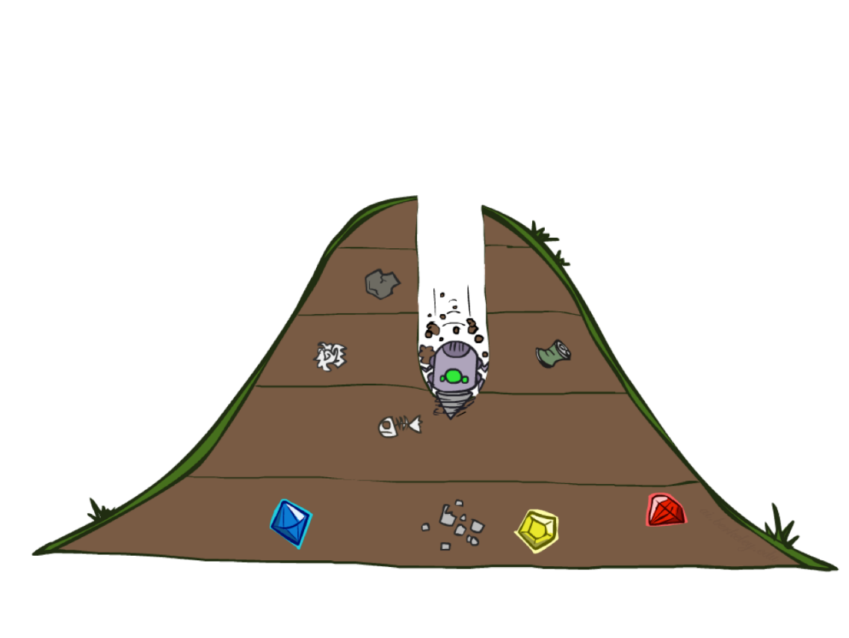
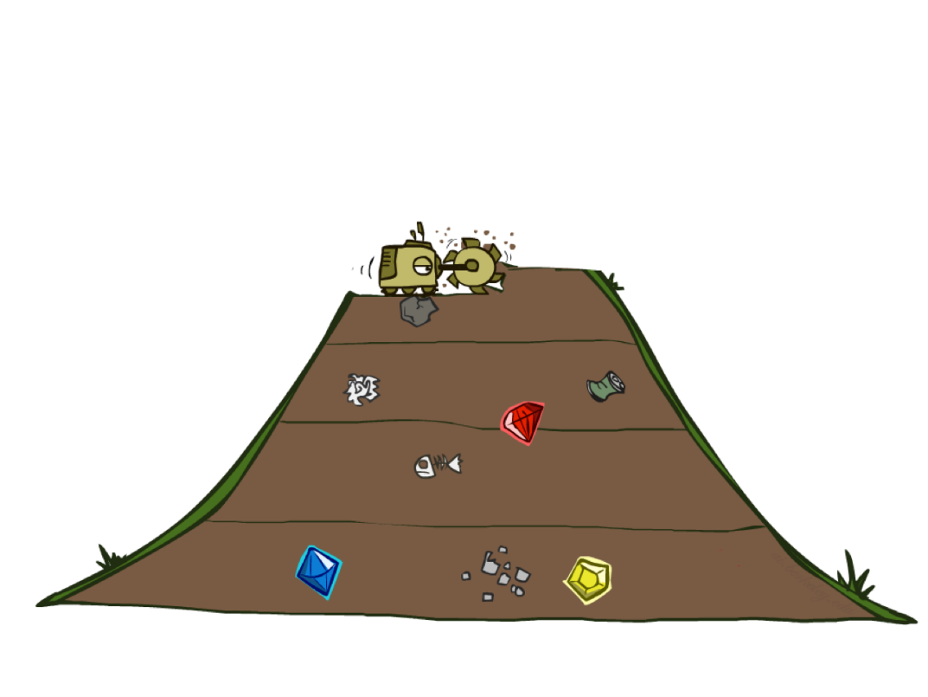
Quiz: DFS vs BFS

Slide 57
Quiz: DFS vs BFS
When will BFS outperform DFS?
When will DFS outperform BFS?
[Demo: dfs/bfs maze water (L2D6)]
Notes:
BFS best when there is a shallow solution, s << m
DFS best when solutions all at m, and fairly common at m

Slide 58

Example: Maze Water DFS/BFS (part 1)
Notes:
This is breadth-first – spreads out in concentric circles from root. Explores a lot of the state space

Slide 59
Example: Maze Water DFS/BFS (part 2)
Notes:
This is DFS – explores less but finds a terrible solution.
Is it checking for repeated states? Yes! (Otherwise it would never complete)

Slide 60
Iterative Deepening
Idea: get DFS’s space advantage with BFS’s time / shallow-solution advantages
Run a DFS with depth limit 1. If no solution…
Run a DFS with depth limit 2. If no solution…
Run a DFS with depth limit 3. …..
Isn’t that wastefully redundant?
Generally most work happens in the lowest level searched, so not so bad!
b
…
Notes:
1 + (1+b) + (1+b+b²) + … + (1+b+…+b^{s}) = (s+1) + sb + (s-1)b² + … + b^{s} = O(b^{s})

Slide 61

Uniform Cost Search

Slide 62
Uniform Cost Search
2
G
a
g(n) = cost from root to n
Strategy: expand lowest g(n)
Frontier is a priority queue sorted by g(n)
b
c
1
8
2
2
e
3
d
f
9
8
2
S
h
1
1
p
q
r
15
0
S
d
3
e
9
p
1
b
4
e
5
h
17
r
11
q
16
c
11
Cost contours
a
6
a
h
13
r
7
p
q
f
p
q
f
8
q
c
G
q
c
a
11
G
10
a

Slide 63
Uniform Cost Search (UCS) Properties
What nodes does UCS expand?
Processes all nodes with cost less than cheapest solution!
If that solution costs C* and arcs cost at least ε , then the “effective depth” is roughly C*/ε
Takes time O(b^{C*/ε}) (exponential in effective depth)
How much space does the frontier take?
Has roughly the last tier, so O(b^{C*/ε})
Is it complete?
Assuming C* is finite and ε > 0, yes!
Is it optimal?
Yes! (Proof next lecture via A*)
b
g ≤ 1
…
C*/ε “tiers”
g ≤ 2
g ≤ 3

Slide 64
Video of Demo Empty UCS

Slide 65
Video of Demo Maze with Deep/Shallow Water --- BFS or UCS? (part 1)
Notes:
Cost 1 for shallow, 2 for deep water. Let students guess which one of the three it is. (This is BFS.)

Slide 66
Video of Demo Maze with Deep/Shallow Water --- BFS or UCS? (part 2)
Notes:
Let students guess which one of the three it is. (This is UCS.)

